Slide 1


Campus Management Application
At
World Skill Center
WEEKLY PROJECT STATUS REPORT
20-Oct-2023

Slide 2
PROJECT SUMMARY
PROJECT NAME | Campus Management Application At World Skill Center(WSC)
SOUL POC | sharmistha.panda@soulunileaders.com | WSC POC | bishnupriya.panda@worldskillcenter.org
PROJECT START DATE | 03-02-2023 | PROJECT END DATE | 03-02-2024
OVERALL PROJECT STATUS (R)ed, (A)mber, (G)reen | DELAY
Red | Likely delay in overall project schedule | Amber | Some Activities are delayed | Green | On track

Slide 3
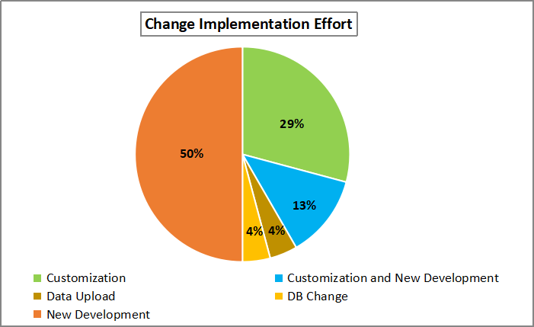
STUDENT APPLICANT CHANGES
No. of Release Planned for SLCM | 2 | Requested Release | 3
No. of Changes Requestes | 24 | Effort Spent for Change Implementation | 330
Releases of the SLCM were scheduled in two phases, priority 1 and priority 2
Priority 1 release date: 31 Aug 2023
The Student Applicant feature, which was part of priority 2, was requested to be Go Live on September 26, 2023

Slide 4
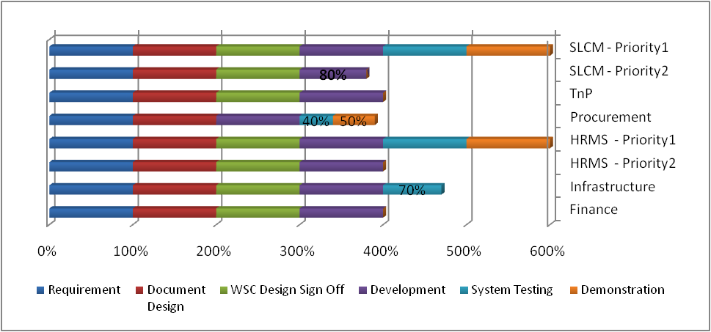
MODULEWISE STATUS
Procurement - WSC design document sign off pending
SLCM Priority 2 - ToT development 80% completed
Procurement and - System testing 40% completed for the respective modules. SOUL team demonstrated the application to WSC stakeholders on 08 September, 2023. Subsequent meeting could not be conducted due to unavailablity of stakeholders
Infrastructure - System testing 70% completed

Slide 5
TASKS PLANNED/ACCOMPLISHED THIS WEEK
Description | Owner | Status | Remarks
Student Admission / Enrollment / Applicant | SOUL - WSC | On-Going | Student admission process for SOE completed on 13 Oct 2023
 |  |  | Training to the WSC trainers on student course enrollment for SOS department by SOUL team ~ 4th October 2023 - Done
 |  |  | Course enrollment of the students (SOS) - started on 4th October 2023 - On-Going
 |  |  | Online Payment by the students (SOS) - started on 4th October 2023 - On-Going
 |  |  | Support to WSC trainers, Accounts team, IT Team to handle students query, issues (defect fix) , change requests- 26 September ~ 13 October 2023 - On-Going
 |  |  | SOUL team provided training to WSC trainers / IT team for SPOT Admission of students at WSC - 12 October 2023 - Done
User / Training Manual | SOUL | OPEN | SOUL team working on the user manual documentation

Slide 6
TASKS PLANNED/ACCOMPLISHED THIS WEEK
SLCM & HRMS Priority 1 Release Status
Description | Owner | Status | Remarks
SLCM priority release features listed in slides 1 to 4 of Campus Management Software At World Skill Center SLCM & HRMS Priority1 Release.ppt embedded in Slide 3 | SOUL - WSC | OPEN | As Student Admission / Enrollment (Applicant) is high priority for WSC, production roll-out of SLCM features (listed in slides 1-4) shall be planned / post Student Admission (Applicant) release
HRMS priority release features listed in slides 6 to 7 of Campus Management Software At World Skill Center SLCM & HRMS Priority1 Release.ppt embedded in Slide 3 | SOUL - WSC | OPEN | As Student Applicant is high priority for WSC, production roll-out of HRMS shall be planned / scheduled post Student Applicant release

Slide 7
OVERALL PROJECT PROGRESS TIMELINE
Milestone 1 - Gap Analysis Document and SRS documents signed off on 12 June, 2023
Milestone 2 - Design Document digital sign off pending from WSC stakeholders

Slide 8
ISSUES
TASKS
Description | Issue Owner | Status | Action Items | Remarks
Integration - Payment Gateway (Axis) | SOUL - WSC | OPEN | WSC IT team to coordinate with Axis bank for issue resolution | SOUL team getting failed merchant authentication response and have initiated a call with Axis team ~ 16 Oct 2023
Application demonstration to WSC stakeholders - Infrastructure / Training& Placement Module | SOUL - WSC | DELAY | WSC IT team should liaise with stakeholders to ensure their availability | 08-Sep-23: The demonstration was scheduled for the week of September 4–8, 2023 however it was canceled due to unavailability of stakeholders Update: No meeting held
Procurement and Inventory management | SOUL - WSC | DELAY | WSC IT team should liaise with stakeholders to ensure their availability | 08-Sep-23:SOUL team demonstrated the application to WSC stakeholders on 08 September, 2023 Update: Subsequent meeting in the week of 11-Sep ~ 15-Sep could not be conducted due to unavailablity of stakeholders
Pending Action Items from WSC | WSC | OPEN | The following information is pending : Roll number format SOP for examination paper setting Final exam result components workflow hierarchy for fee write off approval process Purchase Requisition Workflow | SOUL team had requested WSC IT team for assistance - 20 September 2023

Slide 9
ISSUES
Description | Issue Priority | Proposed Solution | Issue Owner | Status | Action Item | Remarks
A delay in discussing and capturing requirements | High | The revised project plan was discussed on 06-Apr, during weekly Project review meeting update : schedule has been reviwed with WSC stakeholders | WSC | OPEN | WSC stakeholders to acknowledge the delay
SOUL highlighted the addition to scope (change request) for the features that were discovered during the requirements study but were not specified in the request for proposal document | High | WSC stakeholders to acknowledge the change request | WSC | OPEN | The change requests will be acknowledged by WSC | Update: SOUL team sent an email to WSC to acknowledge the change reqests and the additional effort required for development. The change requests have been listed in Slide 8

Slide 10
ISSUES
Description | Issue Priority | Proposed Solution | Issue Owner | Status | Action Item | Remarks
Availability of OCAC server | High | WSC stakeholder to ensure availability of the requested server version | WSC | OPEN | SOUL team has installed the application and database on the same server in the desktop version WSC to acknowledge the additional effort required (CR) to test the desktop version of the application

Slide 11
CHANGE REQUESTS
Description | Module
Entrance Examination Process | Students Management
TrainingOfTrainers(TOT) | Students Management
Recruitment Process | Human Resources Management System
Employee Re-Engagement | Human Resources Management System
Testing effort for application installation in desktop version | OCAC Server
As discussed on 9th June 2023, the change requests Budget and Payroll have been removed from the the list

Slide 12
UPCOMING WORK
WHAT’S NEXT
Description | Owner | Status | Remarks
User Manual Documentation | SOUL | On-Going
Application demonstration to WSC stakeholders | SOUL - WSC | OPEN | SOUL team to check again with WSC IT team for module owners availability

Slide 13
THANK YOU

